Slide 1
Visual Storytelling with Stick Figures
Ziyi Gong, Xingchen Zhao, Haoyue Cui, Sijia Rong
University of Pittsburgh
Mar. 3, 2020

Slide 2
Goal and importance
Goal: Generate new stories of interactions among multiple people
Importance:
Offer novel ideas
Enhance degree of freedom in video games
Provide machine generated data for future researches (e.g. study on human interactions)
Notes:
Stories are engaging, especially the interactions among human. Visual stories are used in many applications such as advertisements, social network memes, and artistic creations.
However, coherent and reasonable stories need professional knowledge, experience and effort to write, so we want and are excited to see how machines generate visual stories from scratch.
A good generative visual storytelling model can work in many aspects, offer novel ideas, enhance freedom degree in video games and provide machine generated data for future research focusing on human interactions, etc, We can see deep learning matters and how deep learning works irl.
But generative approaches require massive data and a story has many elements, (environment, characters, ?), so we can work with stick figures which take less data.

Slide 3
Challenges & Ambition
Need to encode relationships that typically require human cognition to understand
Lack of good data
Unnecessary characters in the background
Sharp / fast transition of scenes
Change in the number of characters
Smooth movements
Randomly generate visual stories
Notes:
Unnecessary characters are in the background, we only want to get the moves of main characters( in a war scene, we will detect all the characters, but we want only the general instead of soldiers)
Sharp / fast transition of scenes make it harder, once the scene is changed, our position data becomes useless thus we cannot keep track of the same person
Change in the number of characters also matters
Smooth movements are more meaningful.
Randomly generating visual stories is our ambition too.

Slide 4
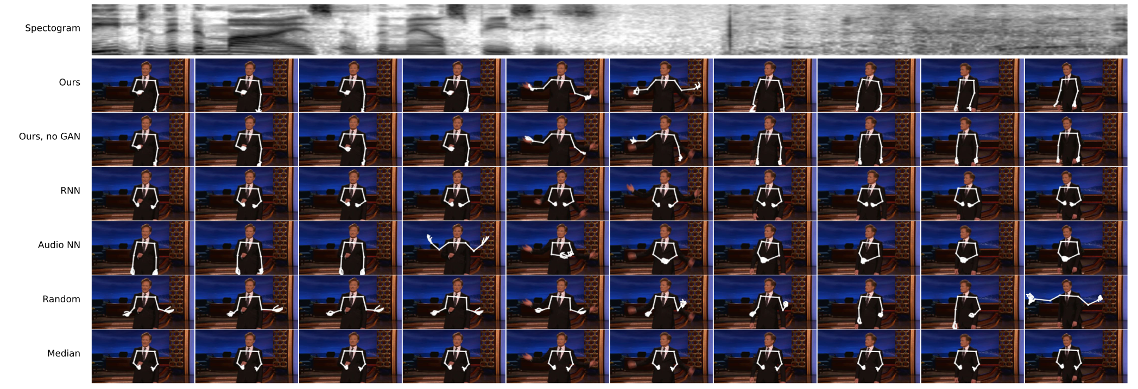
Literature Review & Prior Works
Audio-to-gesture generation (by Ginosar et al. 2018)
Notes:
A very interesting previous work is to generate gestures from speakers’ audios. It is a kind of visual story generation by giving an input of human speech. The researchers believe that there are some natural relations between human sound and their gestures. Just like when I am talking here, my story is not only expressed by my words, but also from my gestures.
In the work they have already done, they used dataset from talk shows and interviews, which are basically a person telling a story. This picture shows the performance of their model. Their model works very well, especially the one with GAN. And we will talk more about GAN later.

Slide 5
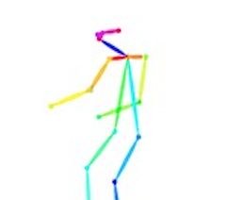
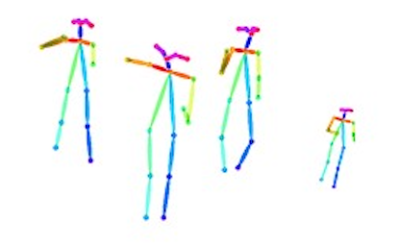
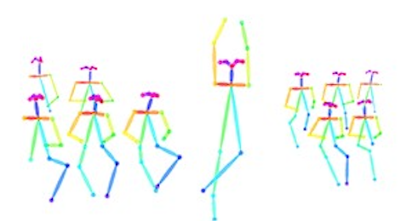
Literature Review & Prior Works
Pose Tracking
Detect a person
Detect his / her keypoints (nose, left & right shoulders, etc.) sequentially
Keep track of the person and keypoints in the future frames
Sample implementations: OpenPose, AlphaPose, etc.
Video datasets: HOLLYWOOD2
Notes:
There are also many works have been done about pose tracking. Pose tracking algorithms such as openpose typically follow the three steps. Detect a person using a pretrained model like YOLO. After that, the keypoints within the person are detected sequentially. From nose to eyes, and all the way to the feet. Then, in the next frame, it will keep track of the person and the person’s keypoints to record the pose change
Hollywood2 is a Human Actions and Scenes Dataset. The dataset is composed of video clips from 69 movies (see the list of movies below). We will use this video dataset to produce our own skeleton dataset by openpose. As shown in this picture, we will use those colorful keypoints and skeletons to as our stick figures.

Slide 6
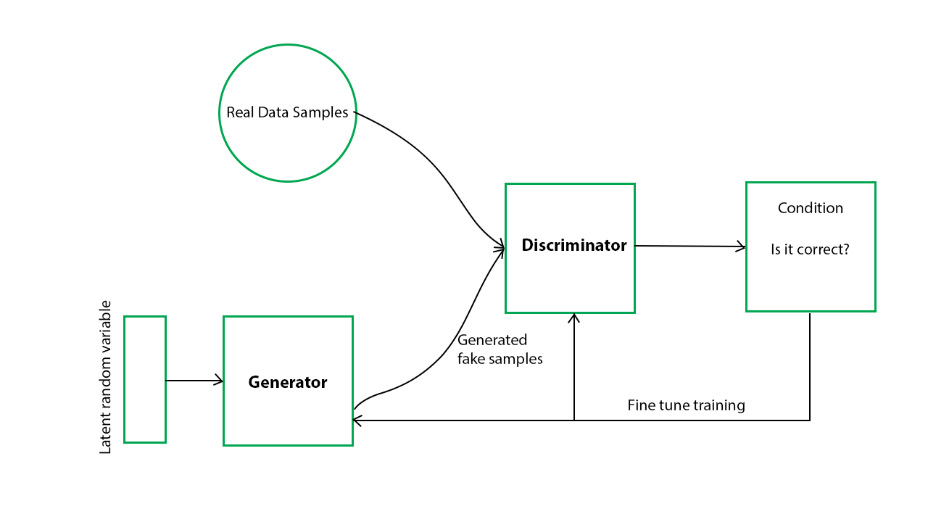
Literature Review & Prior Works
GAN (Generative Adversarial Network, by Goodfellow et al. 2014)
Generator: "I am going to fabricate something to cheat the discriminator."
Discriminator: "What the generator gives me are fake!"
Notes:
Just like previous two groups, we use GAN. The basic idea is that two neural networks are competing: a generator trying to generate movements, and a discriminator trying to tell which input is fake and which is real. Both are trained through iterations, so the generator produces finer and finer movements, and the discriminator becomes pickier and pickier. Therefore, the generator will finally produce very smooth and reasonable movements. Note that the "movements" I mentioned is just the keypoints over some time period, also referred as "skeletons."

Slide 7
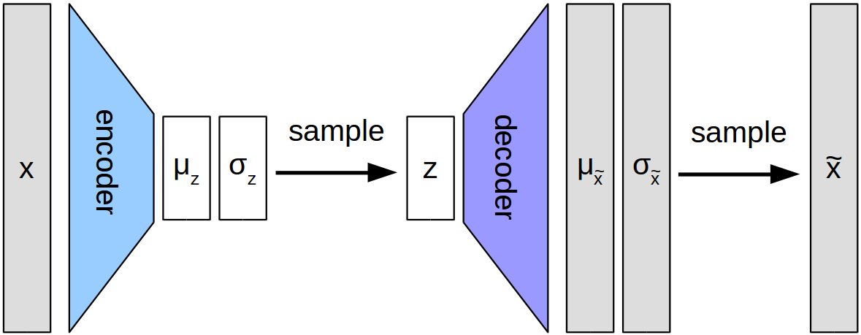
Literature Review & Prior Works
Good generators for GAN
VAE (Variational Autoencoder, by Kingma & Welling 2013)
Encoder: "compress" the input to some range of smaller representations
Decoder: "decompress" some smaller representations back
Notes:
One good generator is VAE. During training, we train an encoder compressing the samples to a range of smaller representations z, and train a decoder to decode some small representations back to the sample space.
I emphasized "range" here because every representation within the range means very similar things. That is, the encoder learns the "prototypes." Technically, the encoder outputs means and standard deviations. Thus, we get a multivariate Gaussian mixture.
After training we can randomly sample some z's from the Gaussian mixture and let the decoder to transform them to sample space. That's how we are going to randomly generate the movements we want.

Slide 8
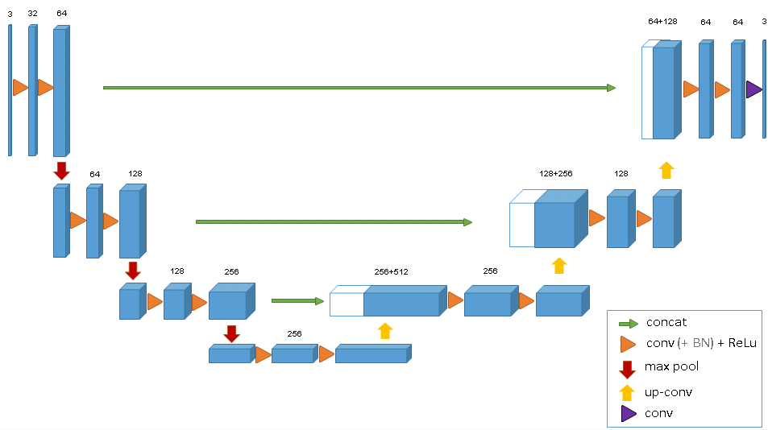
Literature Review & Prior Works
Good generators for GAN
UNet (by Ronneberger 2015)
Skip connections preserve the information in the input
Notes:
Another good generator is UNet, which is also used in the audio-to-gesture generation. Look at the structure you can notice there are connections from early layers directly to later layers. And that connections preserve the information in the input to some degree. Therefore, UNet is good if we do not want to generate things from scratch. And for our model, we are going to use UNet to map a movement to another movement.

Slide 9


Method
Learn
How to randomly generate a movement
How to map a movement to another relevant movement
Stack VAE-GAN with UNet-GAN
Notes:
We propose to stack the two generative models together. VAE & UNet
First, we train a VAE to generate fine movements x1 hat, and D1 says if the movements themselves are fake or not.
Then, we use a UNet to map the generated movement to another related movement x2 hat. The UNet is firstly trained on L2 Loss such that it at first generate movements that make sense.
Finally, we fine tune the decoder and the UNet with a discriminator D2 that takes two related movements. D2 tells whether the relationships are fake or not.
Thus, we have two stick figures that use certain movements to represent interactions between them, and those interactions tell stories.

Slide 10
Novelty
Previous visual storytelling utilizes cues like keywords...
Ours:
Random generation
Learn interactions; do not need to deal with language & texts
Do not limit the number of stick figures
Notes:
Previous visual storytelling models typically use certain cues such as keywords that tell the generators which sets of movements should be looked for. And that puts strong limitations on what the stories are going to be.
Our method however, is supposed to randomly generate visual stories. So, we avoid the problem of limitation due to cues and keywords.
Secondly, we use a UNet to learn the interactions which is the essence of stories that probably cannot be described easily in words. Therefore, that can be an advantage because we do not have to deal with texts.
Thirdly, our pipeline enables generation of an arbitrary numbers of skeletons. We can give UNet x2 hat and get x3 hat, and x4 hat and so on, as long as they can be put together to tell a story.

Slide 11
Questions & Suggestions?

Slide 12
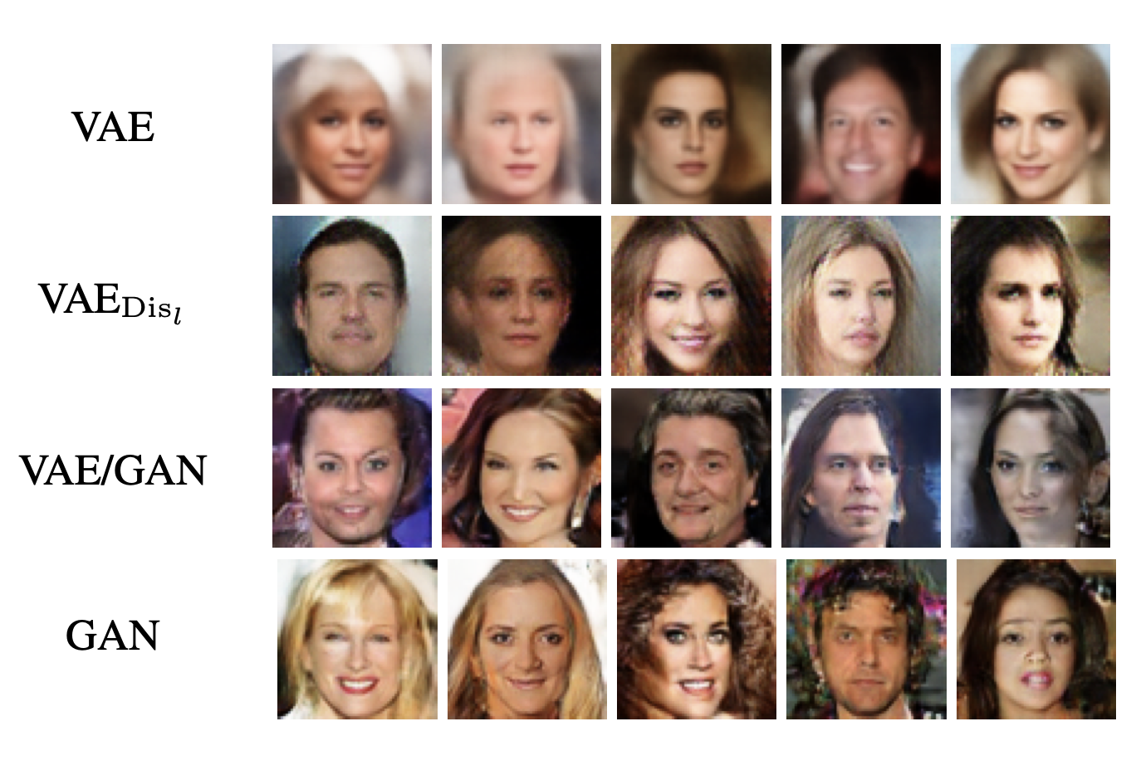
Advantage of VAE-GAN
Samples from different generative models.
Notes:
A major drawback of VAEs is the blurry outputs that they generate. As suggested by Dosovitskiy & Brox, VAE models tend to produce unrealistic, blurry samples. This has to do with how data distributions are recovered and loss functions are calculated in VAEs in which we will discuss further below.
The authors suggested the combination of variational autoencoders and generative adversarial networks outperforms traditional VAEs.

Slide 13
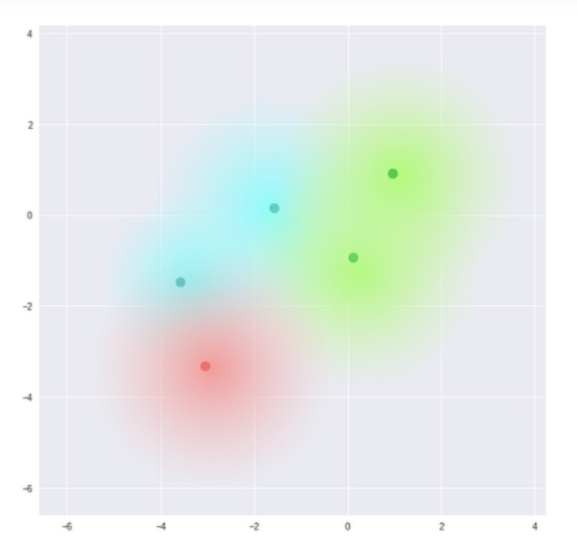
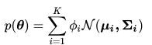
Multivariate Gaussian Mixture Model (MVGMM)

